Slide 1

High Cloud Airlines

Slide 2




Introduction
Objective
Business Overview
Project Scope
Data Challenges & Approach
Data Processing Flow
Dashboards
Recommendations
Conclusion

Slide 3

High Cloud Airlines is a forward-thinking aviation company committed to delivering quality air travel experiences across a wide network of domestic and international routes. The organization stands out for its focus on innovation, safety, and customer-centric operations.
As a data analyst, my goal in this project was to analyze various aspects of the airline’s operations through data to identify opportunities for strategic improvements.
Using modern analytics techniques, this study aims to provide insights that can help the airline improve efficiency, passenger satisfaction, and overall business outcomes.

Slide 4

The main objective of this analysis was to explore operational data from High Cloud Airlines and extract insights that could support decision-making.
This involved evaluating load factors, ranking airlines based on customer preferences, identifying the busiest routes, and assessing performance trends.
Ultimately, the goal was to provide practical, data-driven recommendations that can improve operational efficiency, increase profitability, and support strategic growth.

Slide 5


Business Overview
In the highly competitive airline industry, leveraging data effectively can make a significant difference in terms of cost optimization, customer retention, and strategic planning.
High Cloud Airlines seeks to improve its business outcomes by embracing a data-centric approach.
This project utilizes historical flight and passenger data to identify patterns, performance gaps, and growth opportunities.
Key focus areas included optimizing load factor, improving passenger experience, better allocation of resources, and enabling data-supported decision-making.

Slide 6


This project focuses on understanding key metrics that reflect the airline’s operational efficiency. The scope of work included:
Load factor trends over time
Passenger behavior and preferences
Most frequently traveled routes
Overall efficiency of airline operations
The analysis centered around identifying improvement areas by deeply exploring KPIs that directly influence business outcomes.

Slide 7
Data Challenges & Approach
While working with the data, several challenges were encountered and addressed, including:
Large Dataset Size: Efficient techniques were used for data handling and processing.
Data Quality Issues: Steps were taken to ensure completeness and accuracy.
Complex Relationships: Datasets had to be merged to derive meaningful KPIs, requiring the use of Power Query.
Data Visualization: Creating visual representations for flight routes, customer demographics, and performance metrics.
Market Trends: Analyzing patterns in route usage and airline popularity for strategic decisions.

Slide 8
DATA PROCESSING FLOW
Data Cleaning and transformation
Used power query editor in excel and power bi to clean and transform the data
This includes handling null values, standardizing the Data types, merging the data etc.
Relationship building
Meaningful relationships are established between the tables using pivot tables (Excel), Joins(Tableau) and Data modelling (power Bi)
Visualization and Insights
The cleaned data is loaded and created interactive dashboards
Highlighted the trends, patterns and KPIs to draw actionable insights
Validation of results
The Results acquired from the visualizations are cross checked with that from SQL queries to ensure the accuracy and reliability of dashboards

Slide 9



DASHBOARDS

Slide 10
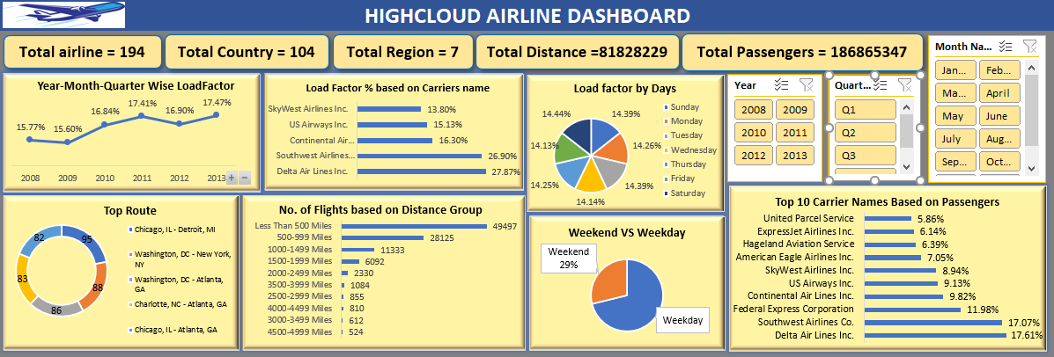
Excel Dashboard

Slide 11
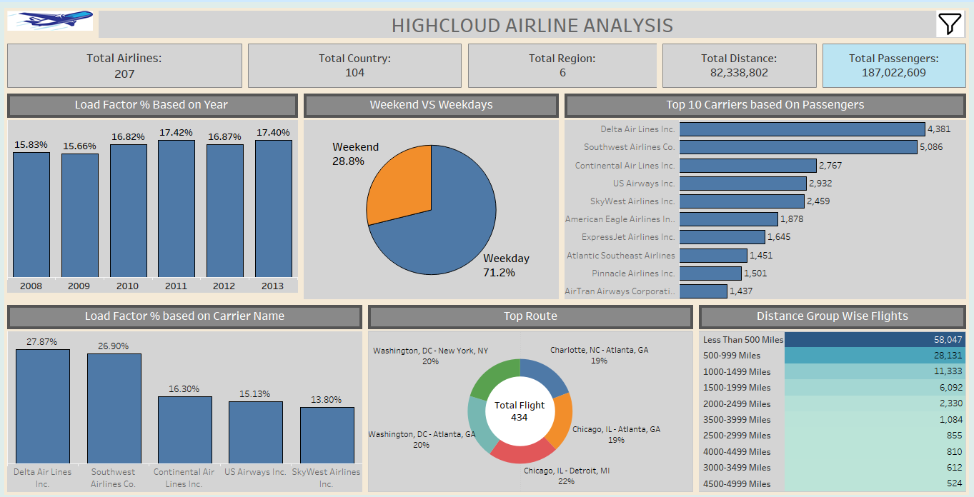
Tableau Dashboard

Slide 12
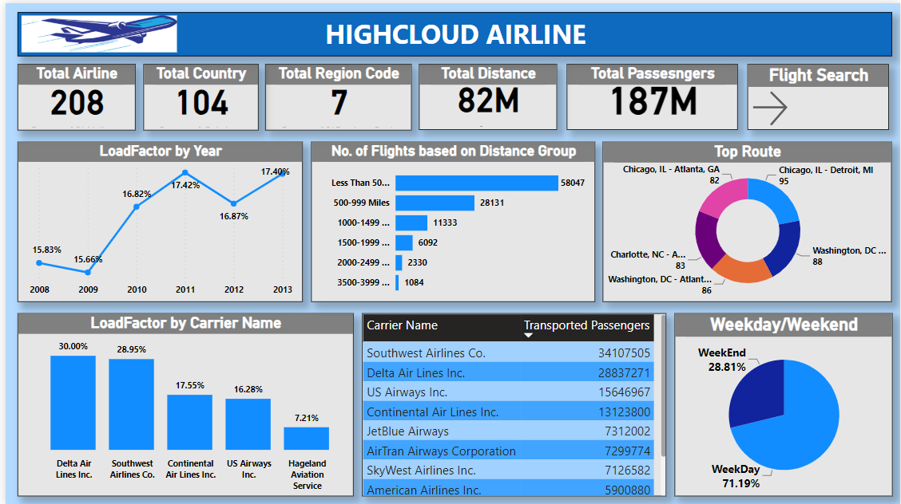
Power BI Dashboard

Slide 13
Recommendations
Based on the analysis, I suggest:
Re-evaluate flight scheduling to align with popular travel periods and optimize resource use.
Boost marketing for underperforming carriers or routes.
Form alliances with top-performing carriers to expand network reach.
Use load factor trends to manage costs and enhance occupancy.
Invest in data monitoring systems for continuous insight into operational performance.

Slide 14

The High Cloud Airlines project demonstrates how data analytics can be used to drive strategic decisions in the airline industry. Through careful examination of operational KPIs, we identified areas of strength and opportunities for growth.
Implementing data-backed strategies can improve performance, reduce costs, and enhance customer satisfaction. With continued analytics integration, High Cloud Airlines can remain competitive and innovative in a dynamic market

Slide 15



